Slide 1
Linear Regression

Slide 2
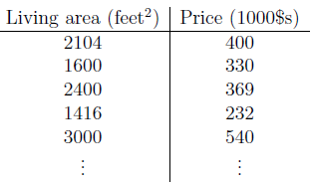
Supervised learning

Slide 3
Notations
x^{(i)} – input variable
y^{(i)} – output variable
Pair(x^{(i)} , y^{(i)}) is i^{th} training example
Total examples- m
h(x) is the good predictor of y.
And h is called as hypothesis.

Slide 4
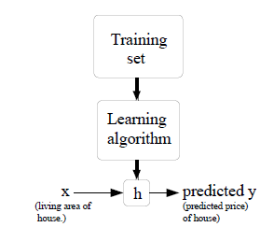

Slide 5
Regression vs Classification
When the target variable that we’re trying to predict is continuous, such as in our housing example, we call the learning problem a regression problem.
When y can take on only a small number of discrete values (such as if, given the living area, we wanted to predict if a dwelling is a house or an apartment, say), we call it a classification problem

Slide 6
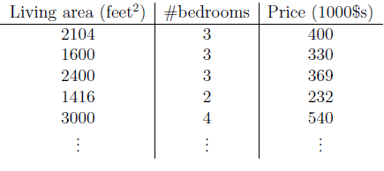
Linear Regression

Slide 7
Notation
Here, the x’s are two-dimensional vectors in R2.
x1^{(i)} is the living area of the i-th house in the training set,
x2^{(i)} is its number of bedrooms.

Slide 8
Suppose y is linear function of x
h_{θ}(x) = θ₀ + θ₁x1 + θ₂x2
Here, the θi’s are the parameters (also called weights) parameterizing the space of linear functions mapping from X to Y.
h(x)=h_{θ}(x)

Slide 9

Where x₀=1
n is no of input variable
Aim is to find the value of θ.

Slide 10

How to find θ
One reasonable method seems to be to make h(x) close to y.
Cost function:
This is least square cost function.

Slide 11
LMS Algo
Start with some initial guess of θ and that repeatedly changes θ to make J(θ) smaller, until hopefully we converge to a value of θ that minimizes J(θ)

Slide 12

Gradient descent algo
starts with some initial θ, and repeatedly performs the update:
α is called the learning rate.
This is a very natural algorithm that repeatedly takes a step in the direction of steepest decrease of J.

Slide 13
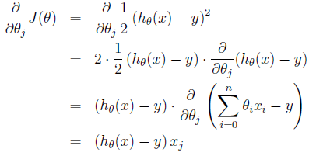
Suppose we have only one training example (x,y)

Slide 14

Update rule for single example is
the magnitude of the update is proportional to the error term (y^{(i)} − h_{θ}(x^{(i)}));

Slide 15
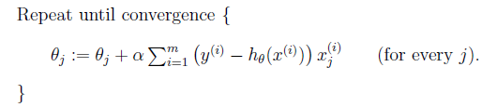
For m examples
This is called as batch gradient descent.
Gradient descent can be susceptible to local minima in general,
for this example linear regression has only one global.
gradient descent always converges (assuming the learning rate α is not too large) to the global minimum.

Slide 16
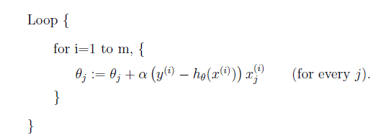
stochastic gradient descent or incremental gradient descent

